Slide 1
Anesthesia consideration for abdominal injury
By: wubayheu Amare (MSc, lecturer)

Slide 2
Outline
Introduction to abdominal injury
Types of abdominal injury
Clinical presentation
Diagnosis of AI
Management of abdominal Injury

Slide 3
introduction to Abdominal Injury
Definition: Trauma or damage to the abdominal organs and structures.
Key Organs in the Abdomen:
Solid Organs: Liver, spleen, kidneys, pancreas.
Hollow Organs: Small intestine, large intestine, bladder.
Vascular Structures: Aorta, inferior vena cava.
Abdominal injuries can result in internal bleeding, organ failure, and life-threatening complications.

Slide 4
Cont..
Types:
Blunt Trauma: No penetration; impact or compression.
Penetrating Trauma: Injury via sharp or projectile objects.
Challenges: Diagnosis can be complex due to overlapping symptoms and the variety of organs involved.

Slide 5
Types of Abdominal Injury
1. Blunt Abdominal Trauma (BAT)
Causes:
MVC, Falls , Sports injuries (e.g., contact sports), Industrial accidents.
Mechanism:
Deceleration: Sudden stopping of the body (e.g., car crash).
Compression: Abdomen compressed between spine and external object.
Direct Impact: Forceful contact with a hard object (e.g., steering wheel, seatbelt).

Slide 6
Cont..
Injuries:
Liver lacerations.
Spleen rupture.
Kidney contusions.
Bowel perforation.
Complications:
Hemorrhagic shock.
Abdominal compartment syndrome.
Bowel obstruction or perforation.

Slide 7
2. Penetrating Abdominal Trauma (PAT)
Causes:
Stab wounds (knife, sharp objects), Gunshot wounds, Impalements.
Object penetrates the abdominal wall, causing direct organ damage.
Injuries:
Bowel perforation.
Liver or spleen lacerations.
Vascular injury (e.g., injury to the aorta, inferior vena cava).
Complications:
Peritonitis.
Sepsis.
Massive bleeding.

Slide 8
Clinical Presentation
Pain:
Localized to injured organ (e.g., right upper quadrant pain for liver, left upper quadrant for spleen).
Rebound tenderness: Suggests peritoneal irritation.
Guarding: Protective abdominal muscle tensing.
Distension:
Abdominal swelling often due to bleeding (hemoperitoneum) or bowel injury.
Signs of Shock:
Hypotension: Due to blood loss.

Slide 9
Cont..
Tachycardia: Increased heart rate compensating for low blood pressure.
Pale, cold, clammy skin.
Altered mental status: Confusion or disorientation.
External Signs:
Bruising (Cullen’s sign, Grey-Turner’s sign): Indicative of internal bleeding.
Wounds: Visible stab or gunshot wounds, foreign objects impaled in the body.

Slide 10
Cont..
Other Symptoms:
Fever: Often secondary to infection or peritonitis.
Nausea/Vomiting: Due to bowel injury or peritoneal irritation.
Absence of bowel sounds: Suggestive of bowel perforation.

Slide 11
Diagnosis of Abdominal Injury
1. Physical Examination:
Inspection: Look for external wounds, bruising, or signs of trauma (e.g., Cullen’s or Grey-Turner’s sign).
Palpation:
Tenderness: Localized or generalized.
Rebound tenderness: Sign of peritoneal irritation.
Rigid abdomen: Can indicate peritoneal hemorrhage or bowel perforation.

Slide 12
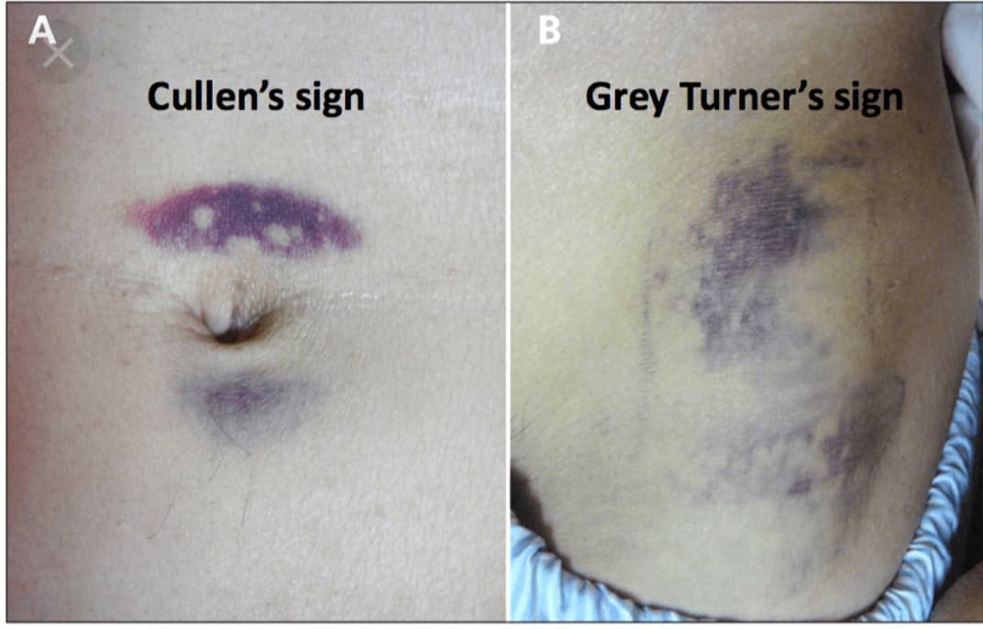

Slide 13
Cont..
Auscultation: Listen for absent or decreased bowel sounds (may indicate bowel perforation).
2. Imaging:
CT Scan (Contrast-Enhanced):
Gold standard for blunt abdominal trauma.
Identifies organ lacerations, bleeding, and free fluid in the abdomen.
FAST Ultrasound: Quick, bedside assessment for free fluid (e.g., blood) in the abdomen.

Slide 14
Cont…
X-ray: Used for detecting free air in the abdomen (indicating bowel perforation).
Diagnostic Peritoneal Lavage (DPL): Used when imaging is inconclusive or unavailable, it detects blood or bile in the peritoneal cavity.

Slide 15
Management of Abdominal Injury
Initial Stabilization:
Airway Management:
Ensure patent airway, especially if the patient has a head injury or is at risk for aspiration.
Hemodynamic Support:
Fluid resuscitation: Administer isotonic fluids (e.g., Normal Saline or Ringer’s Lactate) to stabilize the patient.

Slide 16
Cont..
Blood transfusion: If there is significant blood loss, consider blood products (PRBCs, plasma, platelets).
Oxygen:
Administer oxygen to improve tissue oxygenation, especially if the patient is in shock.

Slide 17
Cont..
Surgical Management:
Exploratory Laparotomy: Performed in patients with:
Penetrating trauma.
Hemodynamic instability (persistent shock).
Intra-abdominal hemorrhage.
Organ Repair:
Suturing lacerations of solid organs (liver, spleen).

Slide 18
Cont..
Bowel resection and anastomosis for perforated bowel.
Splenectomy/Hepatectomy: In cases of severe damage to the spleen or liver.
Conservative Management:
Minor Solid Organ Injury (e.g., small liver or spleen lacerations) can be managed non-operatively:
Bed rest and serial imaging to monitor for changes.

Slide 19
Antibiotics and Pain Management
Antibiotics:
Penetrating trauma involving bowel injury requires broad-spectrum antibiotics:
Prevents peritonitis and sepsis.
Common regimens: Piperacillin-tazobactam or Ceftriaxone with Metronidazole.
.

Slide 20
Cont..
Pain Management
Opioids: For moderate to severe pain.
Examples: Morphine, Fentanyl
Non-opioid analgesics: NSAIDs (e.g., Ibuprofen) for mild pain, though generally avoided in hemorrhagic trauma.
Regional Anesthesia: Epidural anesthesia or nerve blocks to reduce systemic opioid requirements.

Slide 21
Complications of Abdominal Injury
Sepsis:
Peritonitis from bowel perforation or contamination due to penetrating trauma.
Requires urgent antibiotic therapy and sometimes surgical drainage.
Hemorrhagic Shock:
Due to massive blood loss from organ rupture or vascular injury.
Requires immediate fluid resuscitation and possibly massive transfusion protocols.

Slide 22
Cont..
Abdominal Compartment Syndrome (ACS):
Elevated intra-abdominal pressure leading to organ dysfunction (renal failure, respiratory compromise).
Decompression surgery may be required if intra-abdominal pressure exceeds 20 mmHg.

Slide 23
cont,…
Organ Failure:
Liver or kidney failure due to direct injury or shock.
Intestinal failure from bowel resection or prolonged ischemia.
Post-traumatic Ileus:
Temporary bowel paralysis after abdominal trauma, often resolving with supportive care.

Slide 24
Special Considerations
Pregnancy:
Intra-abdominal trauma in pregnant patients requires careful consideration of both maternal and fetal well-being.
Maternal resuscitation is the priority; fetal monitoring (e.g., ultrasound, fetal heart rate) may be necessary if the fetus is viable.
Position the patient left lateral to minimize aortocaval compression.

Slide 25
Cont..
Pediatric Trauma:
Pediatric patients have different fluid resuscitation needs (e.g., smaller volume boluses).
Anesthetic drugs and doses are adjusted based on age and weight (e.g., Ketamine may be preferred for its hemodynamic stability).

Slide 26
Reference
1.Paul G Barash: Handbook of Clinical Anesthesia (8th edition). Lippincott Williams & Wilkins publications, Inc., 2016.
2.Robert K Stoelting: Stoelting’s anesthesia and co-existing disease (5th edition). Churchill Livingstone, an Imprint of Elsevier, 2002.
3.Alan R Aitkenhead: Textbook of Anaesthesia (6th edition). Churchill Livingstone publication, an Imprint of Elsevier, 2001.
4.G. Edward Morgan: Clinical Anesthesiology (6th edition). McGraw-Hill Companies, Inc. 2006

